Slide 1
KL FACULTY FEEDBACK APP
Course code-15TS301
160030231 – Ch.Vijaya Lakshmi
160031003 – Venkat Reddy
160031555- P.G Jahnavi

Slide 2
ABSTRACT
The objective of this application is to make the process of taking feedback from the students in online regarding the lecturer’s teaching. With this, the institutes can access the feedback reports in a faster way and without any loss of data. The application should evaluate the answers given by the students based on the feedback and grade has to be generated to the faculty.

Slide 3
METHODOLOGY
Student will login in their login form with proper id and password. Student can rate their faculty members according to their teaching style, knowledge, discipline and punctuality. Faculty can view total evaluated feedback given by students.
Our project is composed of three modules:
1. Login Module
2. Student Module
3. Faculty Module

Slide 4
Login Module:
Student and Faculty can login using their username and password. Information regarding student and faculty is stored in database. Login is successful only when username and password entered are in database.
Student Module:
Once student logins using their username and password student’s details namely Student’s name, id, section are displayed. Student selects the subject and gives the feedback for the respective faculty. Feedback given by the student is stored in faculty database.

Slide 5
Faculty Module:
After successful login of the faculty , the details of the faculty : Name, Id, Section are displayed . Faculty can view their feedback percentage and number of students who have submitted their feedback. Feedback percentage is calculated on basis of the response given by the student.
Feedback Percentage= ( no . of points given by the students) *100/(Total number of points)
If the student opts for Excellent or Good then the faculty is awarded with one point.

Slide 6
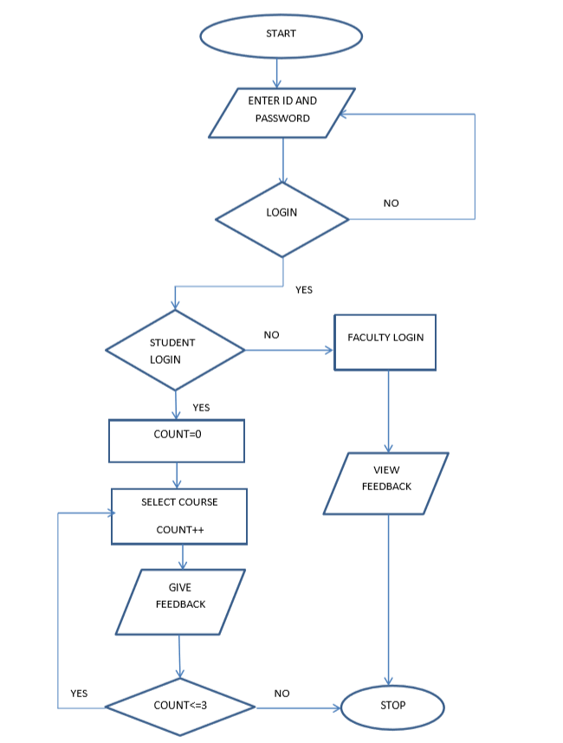
DATA FLOW DIAGRAM

Slide 7
IMPLEMENTATION
Concepts that are used in the implementation of the project are:
Explicit Intent
SQLite Database
Radio Button
Spinner

Slide 8
Explicit Intent:
It specifies which application will satisfy the intent, by supplying either the target app's package name or a fully-qualified component class name. You'll typically use an explicit intent to start a component in your own app, because you know the class name of the activity or service you want to start. For example, you might start a new activity within your app in response to a user action, or start a service to download a file in the background.

Slide 9
SQLite Database:
It is an open source relational database that is used to perform database operations on android devices such as storing, manipulating, retrieving, persistence data from database. It is embedded in android by default so there is no need to perform any database support.
The main package is android.database.sqlite that contains the classes to manage your own databases.
SQLiteOpenHelper , it provides the functionality to use SQLite Databases.

Slide 10
The android.database.sqlite.SQLiteOpenHelper class is used for database creation and version management. For performing any database operation you have to provide the implementation of onCreate() and onUpgrade() methods in SQLiteOpenHelper class.
onCreate(): It will be called when there is no database and the app needs one.
onUpgrade(): it will be called when schema version that we need doesn’t match with schema version of database. Hence we can figure out the best way to convert the database from older to new version.

Slide 11
Radio Button:
Radio buttons allow the user to select one option from a set. You should use radio buttons for optional sets that are mutually exclusive. To create each radio button option, create a radio button in your layout. However, because radio buttons are mutually exclusive, you must group them together inside a radio group. By grouping them together, the system ensures that only one radio button can be selected at a time.
Spinner:
Spinners provide a quick way to select one value from a set. In the default state, a spinner shows its currently selected value. Touching the spinner displays a dropdown menu with all other available values, from which the user can select a new one.

Slide 12
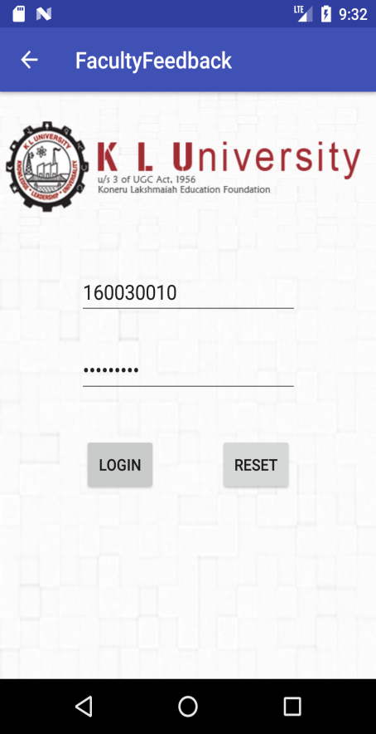

OUTPUT SCREENS
Login Screen:
This is the login screeen.Login can be done by either Student or Faculty.
If login is done by student the above activity contaning image is displayed.Student has to click on this image togo to next activity

Slide 13
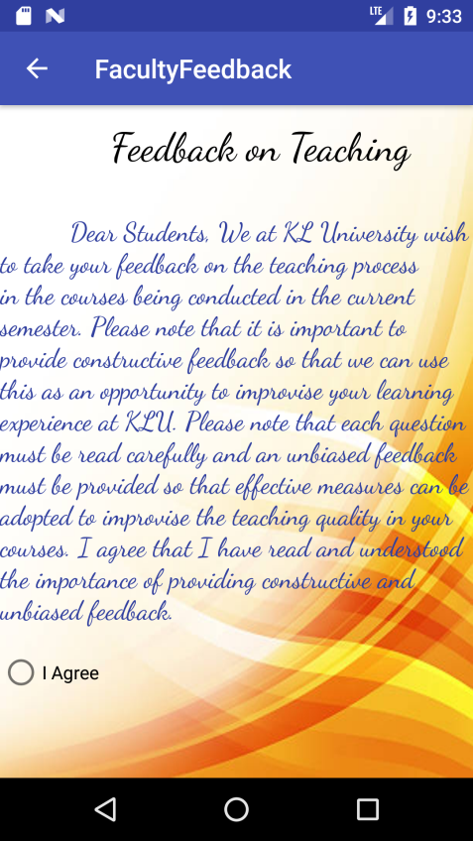
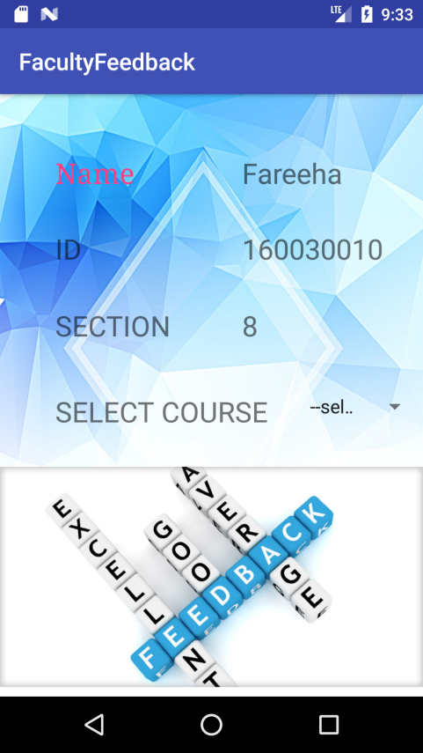
In this activity we need to agree to the terms given by the University while giving feedback.
In this page the details of the student are displayed (Name,ID,Section) and student need to select the subject to give the feedback. After selecting subject the respective subjects feedback form will be displayed

Slide 14
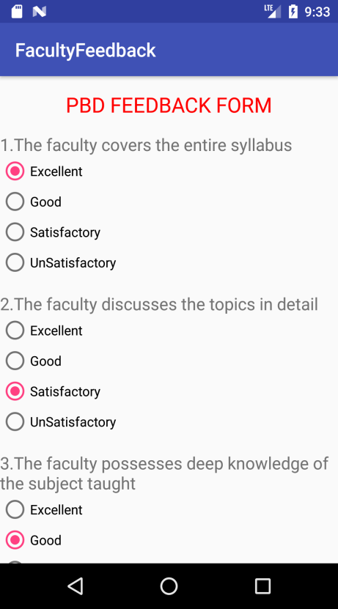
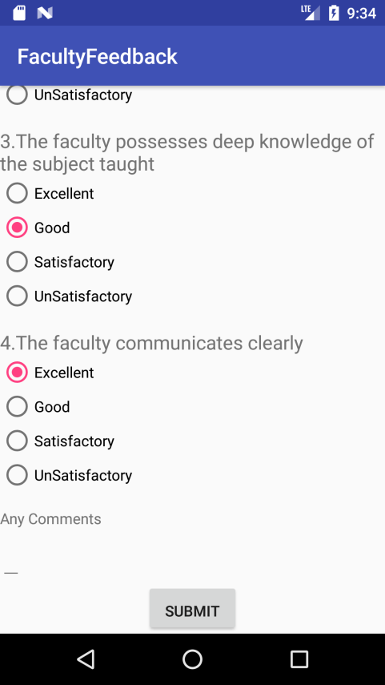
This is the feedback form regarding pbd subject. Student has to submit response for given questions. After submitting their feedback, response will be stored in their respective faculty database. Once the feedback is submitted it will be directed to the subject section page.

Slide 15
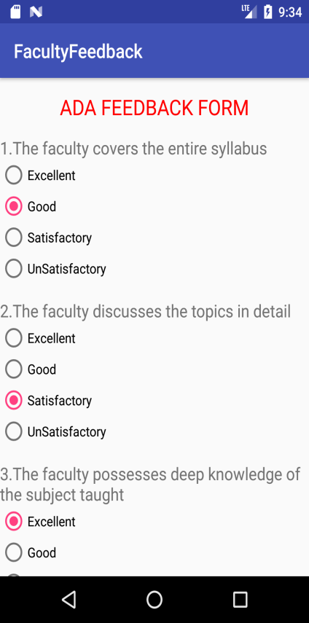
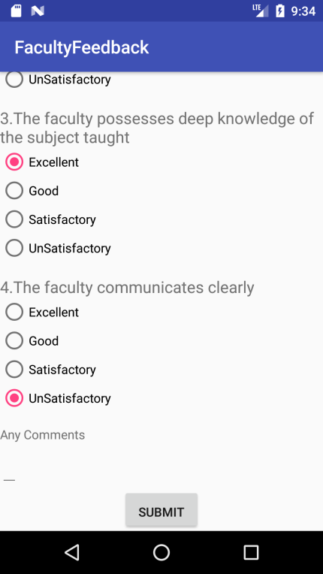
The above are the feedback forms of other subjects. Once all subjects feedback is given it will be directed to the final page.

Slide 16
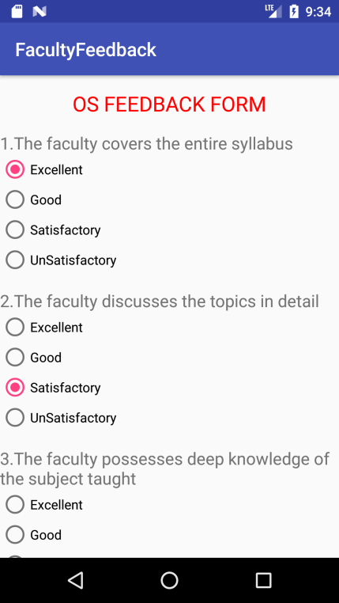


The above is the feedback form of OS subject. Once all subjects feedback is given it will be directed to the final page.

Slide 17
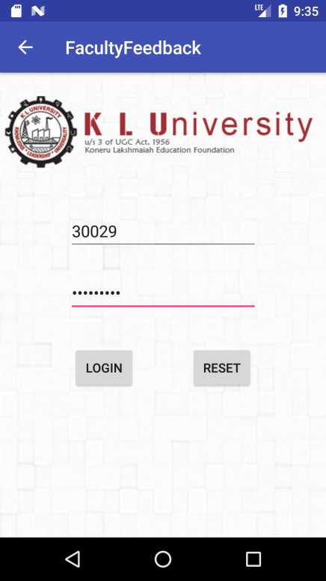

When the faculty enters valid UserID and Password, It will be directed to the above page which contains image.If user clicks on image it will direct to the other activity which contains details of the faculty who is currently logged in.

Slide 18
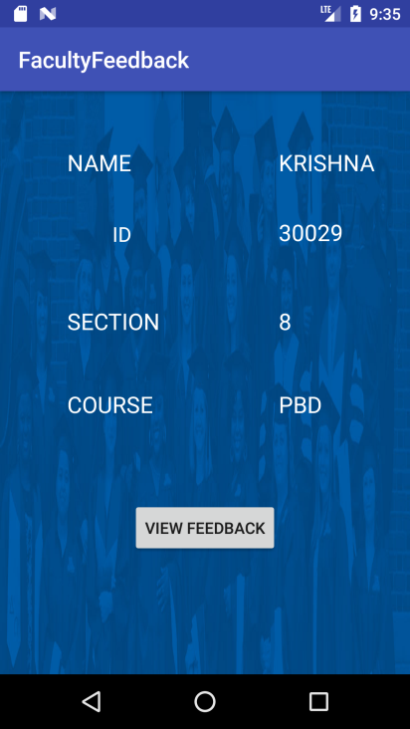
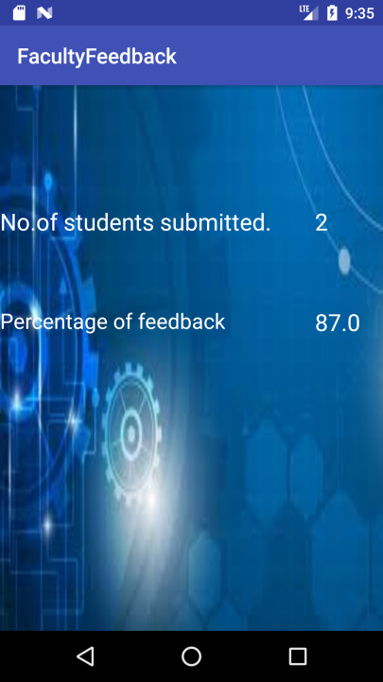
The above activity contains the details of the faculty who is currently logged in. He can view the feedback of his respective subject by clicking on View Feedback button. After clicking on View Feedback button It will display the percentage of feedback given by students and the no of students displayed.

